Slide 1
Create a list of Software
Application Details
Presented By,
M.Pavithra
B.E CSE

Slide 2
PROBLEM STATEMENT
To write a Python program to create a list of software application details. The details of application include name, author, version, publishing year , price.
LANGUAGE
Python

Slide 3
SOURCE CODE:
Importing Module
from tkinter import *
Import libraries from the tkinter module

Slide 4
Initializing window
root = Tk()
root.geometry('800x800')
root.config(bg = 'SlateGray3')
root.resizable(0,0)
root.title('Book Details')
booklist = [
['Object Oriented Programming Using C++ and Java', 'Vasappanavara Ramesh','2','2011','Rs.511'],
['Concepts of database management system', 'Abraham Silberschatz ','4','2019','Rs.499'],
['Mastering Cloud Computing', 'Rajkumar Buyya','3','2018','Rs.299'],
['HTML and CSS: Design and Build Websites', 'Jon Duckett','5','2011','Rs.450'],
['Python: The Complete Reference', 'Martin C. Brown','4','2018','Rs.610'],
['Machine Learning For Absolute Beginners', 'Oliver Theobald ','6','2017','Rs.1000'],
]

Slide 5
Name = StringVar()
Author = StringVar()
Version=StringVar()
Year=StringVar()
Price=StringVar()
frame = Frame(root)
frame.pack(side = RIGHT)
scroll = Scrollbar(frame, orient=VERTICAL)
select = Listbox(frame, yscrollcommand=scroll.set, height=12)
scroll.config (command=select.yview)
scroll.pack(side=RIGHT, fill=Y)
select.pack(side=LEFT, fill=BOTH, expand=1)

Slide 6
Tk() use to initialized tkinter
geometry() sets the window width and height
title() used to set window’s tiltle
resizable(0,0) this command stop window to resize
bg use to set the background color of the window
Contacts’ information is stored in contactlist
Frame is like a container that is used to organized widgets
Here Scrollbar widget and Listbox widget is used to allow users to select from many options

Slide 7
Define functions
def Selected():
return int(select.curselection()[0])
def AddBook():
booklist.append([Name.get(), Author.get(),Version.get(),Year.get(),Price.get()])
Select_set()
def EDIT():
booklist[Selected()] = [Name.get(), Author.get(),Version.get(),Year.get(),Price.get()]
Select_set()
def DELETE():
del booklist[Selected()]
Select_set()
def VIEW():
NAME, AUTHOR,VERSION,YEAR,PRICE = booklist[Selected()]
Name.set(NAME)
Author.set(AUTHOR)
Version.set(VERSION)
Year.set(YEAR)
Price.set(PRICE)

Slide 8
def EXIT():
root.destroy()
def RESET():
Name.set('')
Number.set('')
def Select_set() :
booklist.sort()
select.delete(0,END)
for name,author,version,year,price in booklist :
select.insert (END, name)
Select_set()

Slide 9
Selected() function used to return selected value
Addcontact() function used to add new contact
EDIT() function will edit existing contact
DELETE() function will delete selected contact
VIEW() function will view selected contact
EXIT() used to destroy mainloop
RESET() will set the name and number field to empty string
Select_set() will sort the manage the contactlist and also used in other functions

Slide 10
Define buttons and labels
Label(root, text = 'NAME', font='arial 12 bold', bg = 'SlateGray3').place(x= 30, y=20)
Entry(root, textvariable = Name).place(x= 130, y=20)
Label(root, text = 'AUTHOR', font='arial 12 bold',bg = 'SlateGray3').place(x= 30, y=40)
Entry(root, textvariable = Author).place(x= 130, y=40)
Label(root, text = 'VERSION', font='arial 12 bold', bg = 'SlateGray3').place(x= 30, y=60)
Entry(root, textvariable = Version).place(x= 130, y=60)
Label(root, text = 'YEAR', font='arial 12 bold',bg = 'SlateGray3').place(x= 30, y=80)
Entry(root, textvariable = Year).place(x= 130, y=80)
Label(root, text = 'PRICE', font='arial 12 bold', bg = 'SlateGray3').place(x= 30, y=100)
Entry(root, textvariable = Price).place(x= 130, y=100)

Slide 11
Button(root,text=" ADD", font='arial 12 bold',bg='SlateGray4', command = AddBook).place(x= 50, y=210)
Button(root,text="EDIT", font='arial 12 bold',bg='SlateGray4',command = EDIT).place(x= 50, y=260)
Button(root,text="DELETE", font='arial 12 bold',bg='SlateGray4',command = DELETE).place(x= 50, y=310)
Button(root,text="VIEW", font='arial 12 bold',bg='SlateGray4', command = VIEW).place(x= 50, y=160)
Button(root,text="EXIT", font='arial 12 bold',bg='tomato', command = EXIT).place(x= 400, y=420)
Button(root,text="RESET", font='arial 12 bold',bg='SlateGray4', command = RESET).place(x= 50, y=350)
root.mainloop()

Slide 12
Label() widget used when we want to display text
Entry() widget used when we want to create an input text field.
Button() widget used to display button
root is the name of our window
text which display on the label as title of that label
font in which form the text will be write
textvariable used to retrieve the text to entry widget
place() – place widgets at specific position
command called the specific function when the button will clicked

Slide 13
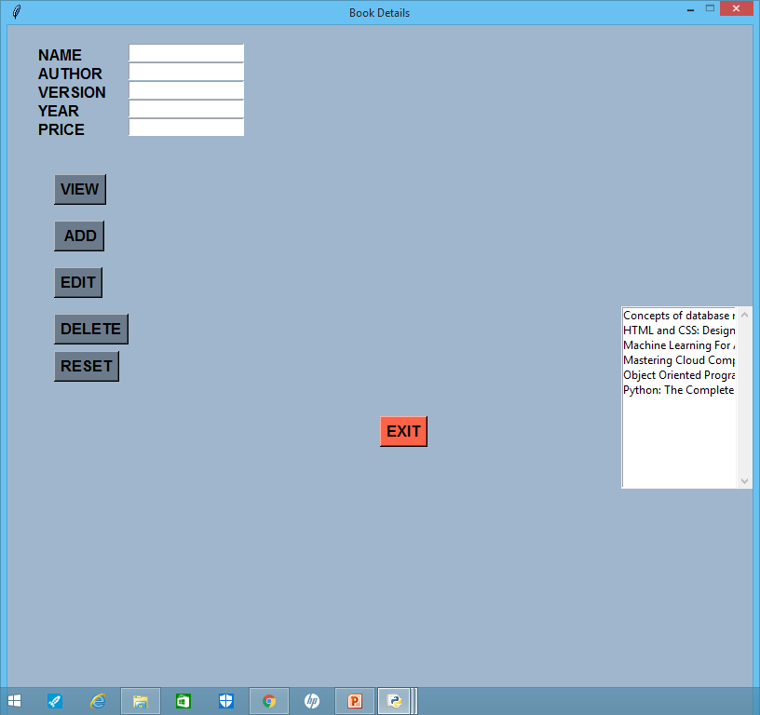
PROJECT OUTPUT

Slide 14
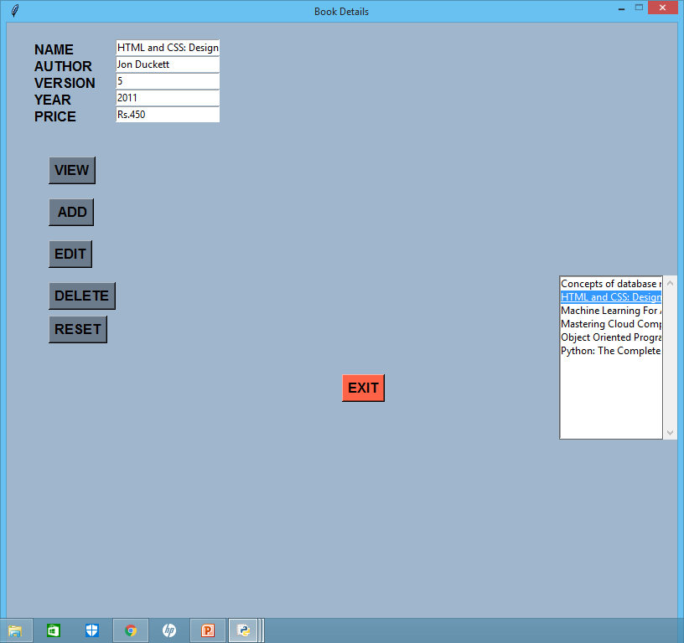
VIEW OF DETAILS

